Slide 1







IOT WORKLOAD CHARACTERIZATION IN NEXT GENERATION CLOUD SYSTEMS UPDATE
Supervised by: Dr. Karan Mitra, Dr. Saguna Saguna,
Dr. Christer Åhlund
Presented by: Fatema Mirza

Slide 2






Latest additions
TABLE OF CONTENTS
fatmir-0@student.ltu.se

Slide 3
01
Latest additions
fatmir-0@student.ltu.se

Slide 4
AIC, BIC, HQIC
The Akaike Information Critera (AIC) is a widely used measure of a statistical model. It basically quantifies 1) the goodness of fit, and 2) the simplicity/parsimony, of the model into a single statistic.
In statistics, the Bayesian information criterion (BIC) or Schwarz criterion (also SBC, SBIC) is a criterion for model selection among a finite set of models. It is based, in part, on the likelihood function, and it is closely related to Akaike information criterion (AIC)
The Hannan-Quinn information criterion (HQC) is a measure of the goodness of fit of a statistical model and is often used as a criterion for model selection among a finite set of models. It is not based on log-likelihood function (LLF), and but related to Akaike's information criterion.

Slide 5
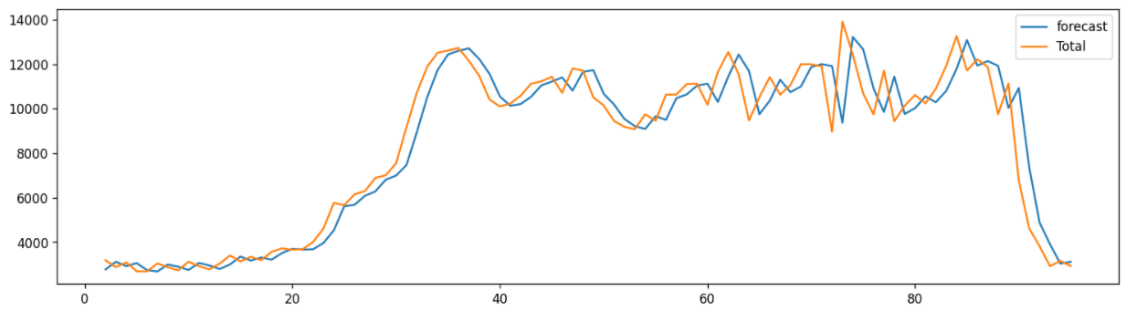
15 minutes ALL apartment ALL selected months

Slide 6
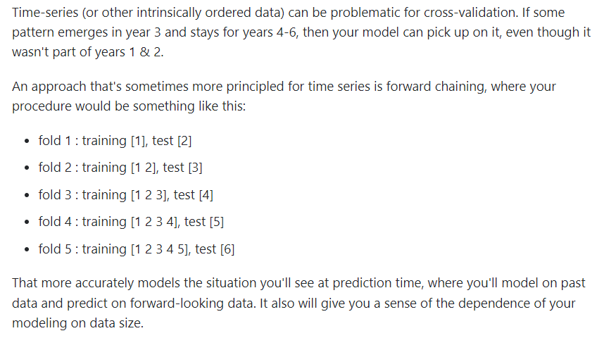
K FOLD CV
This was done using k fold for time series in a method called forward chaining.

Slide 7
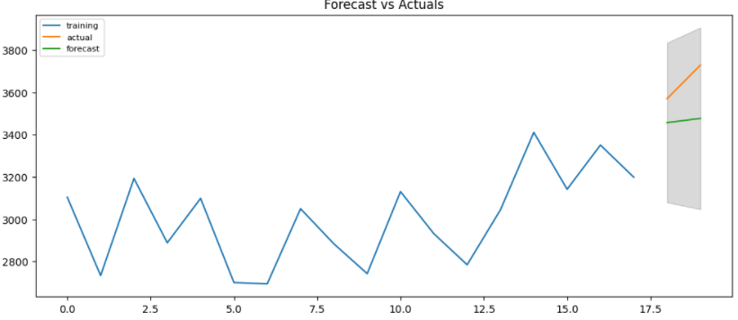
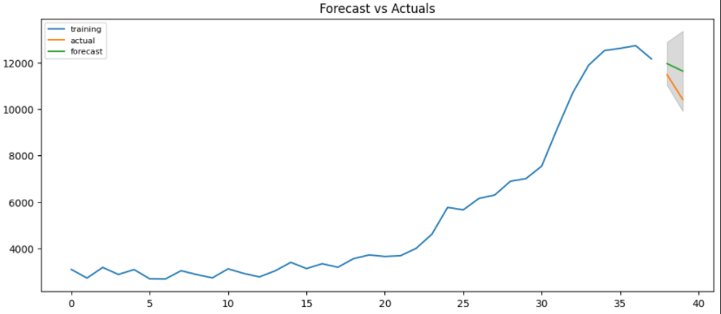
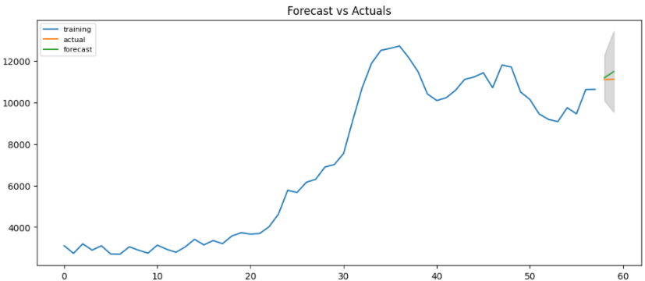
ARIMA Forecasting
18 training, 2 testing
38 training, 2 testing
58 training, 2 testing

Slide 8
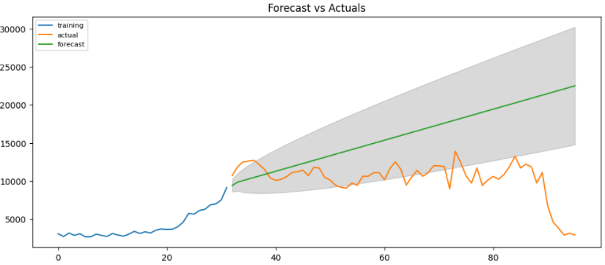
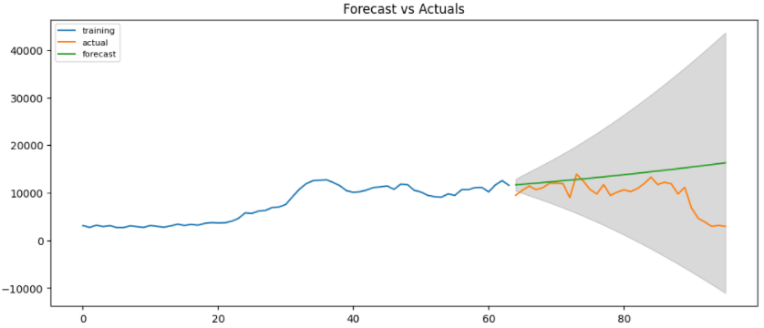
ARIMA Forecasting
32 training, 64 testing
64 training, 32 testing

Slide 9
ARIMA Forecasting Results

Slide 10
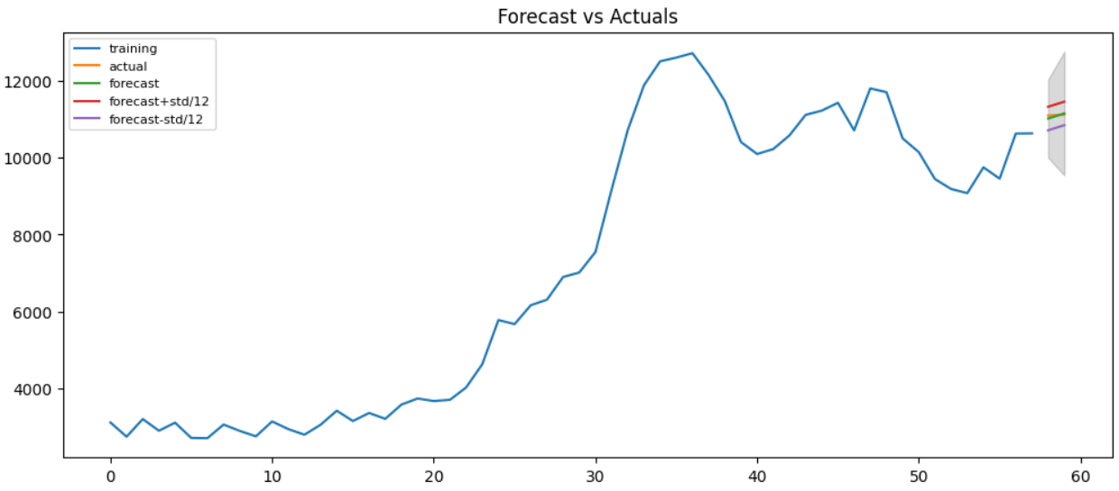
ARIMA Forecasting + std

Slide 11

Thank you! Tack så mycket
Any Questions?
fatmir-0@student.ltu.se

